Slide 1

Genesis 31

Slide 2
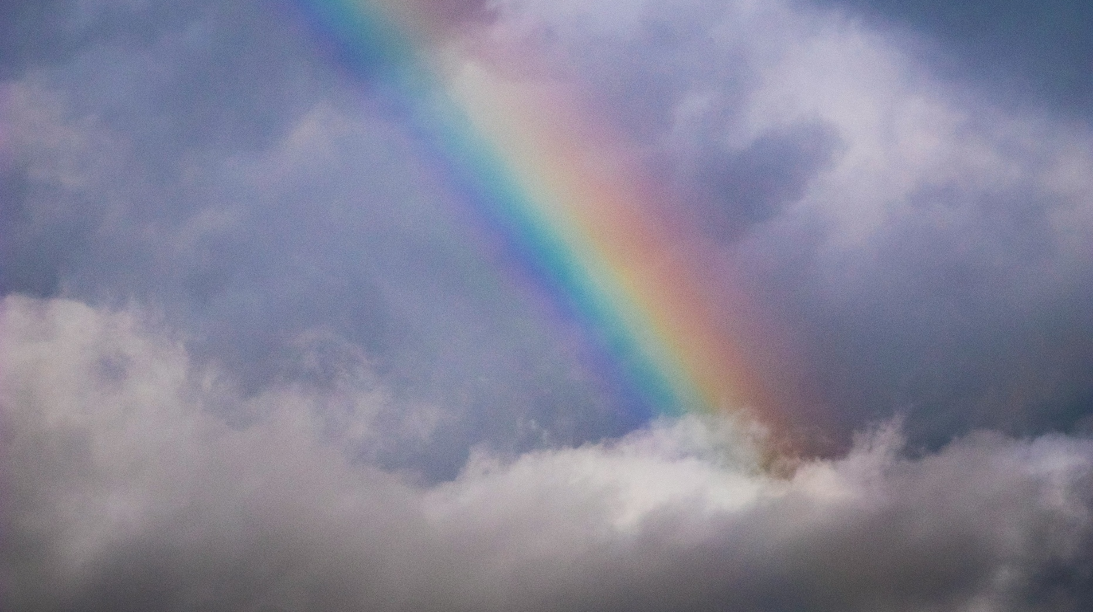
1) Deliverance as promised

Slide 3
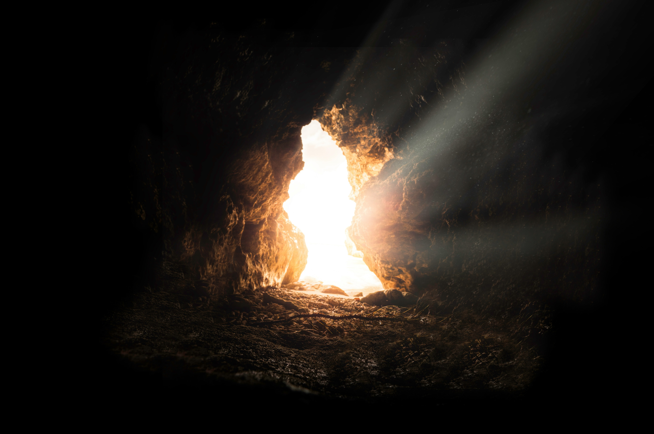
2) Deliverance from darkness

Slide 4
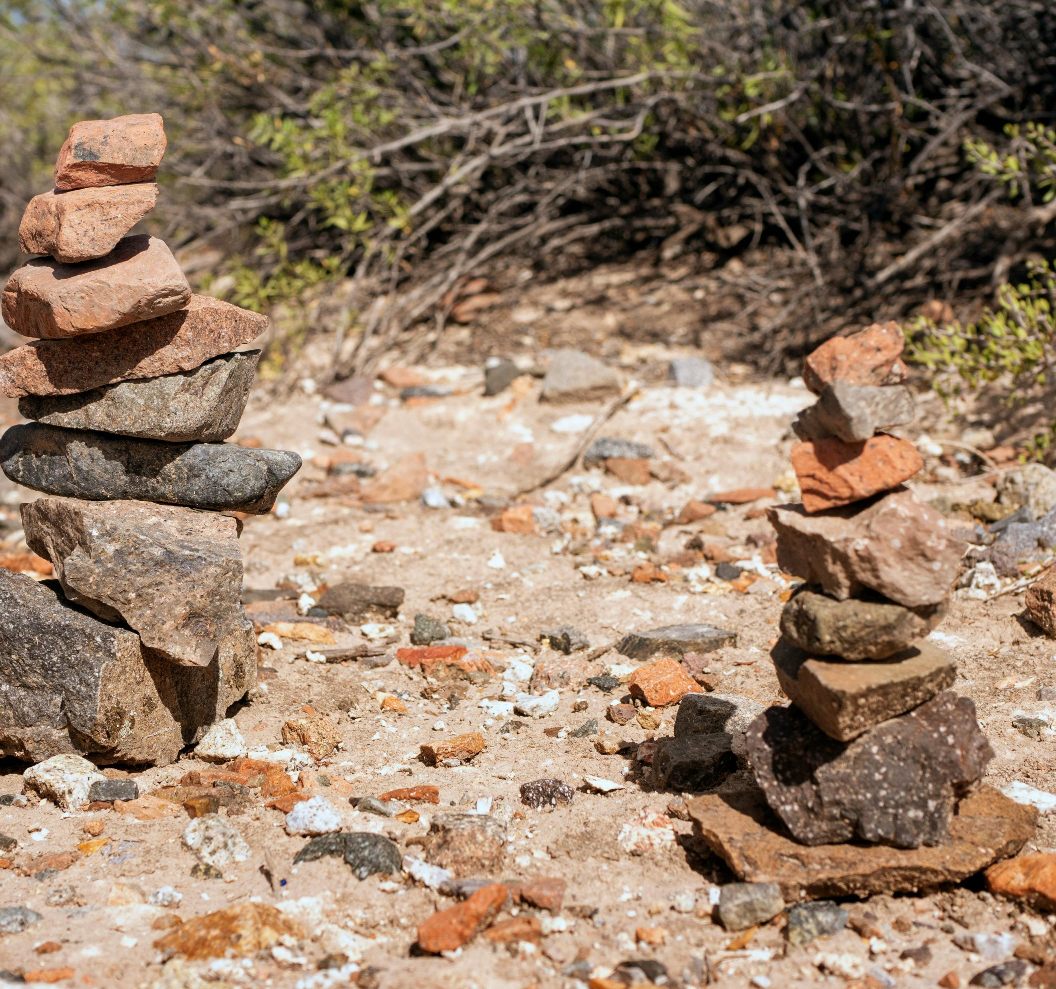
3) Deliverance recognised

